Slide 1
Time Series Analysis
Basics of Time Series Analysis
Nicoleta Serban, Ph.D.
Associate Professor
Stewart School of Industrial and Systems Engineering
The Concept of Stationarity

Slide 2
About this lesson

Slide 3
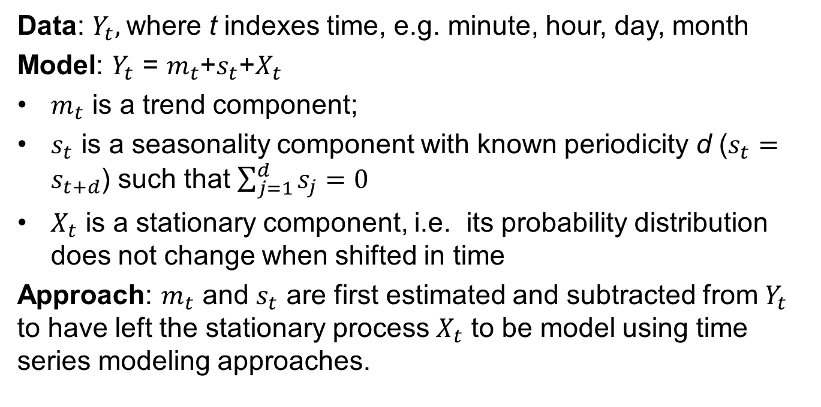
Time Series: Basics
Data: $Y_{t},$where t indexes time, e.g. minute, hour, day, month
Model: $Y_{t}$ = $m_{t}$+$s_{t}$+$X_{t}$
$m_{t}$ is a trend component;
$s_{t}$ is a seasonality component with known periodicity d ($s_{t}=s_{t+d}$) such that $\sum_{j=1}^{d}{s_{j}}=0$
$X_{t}$ is a stationary component, i.e. its probability distribution does not change when shifted in time
Approach: $m_{t}$ and $s_{t}$ are first estimated and subtracted from $Y_{t}$ to have left the stationary process $X_{t}$ to be model using time series modeling approaches.

Slide 4
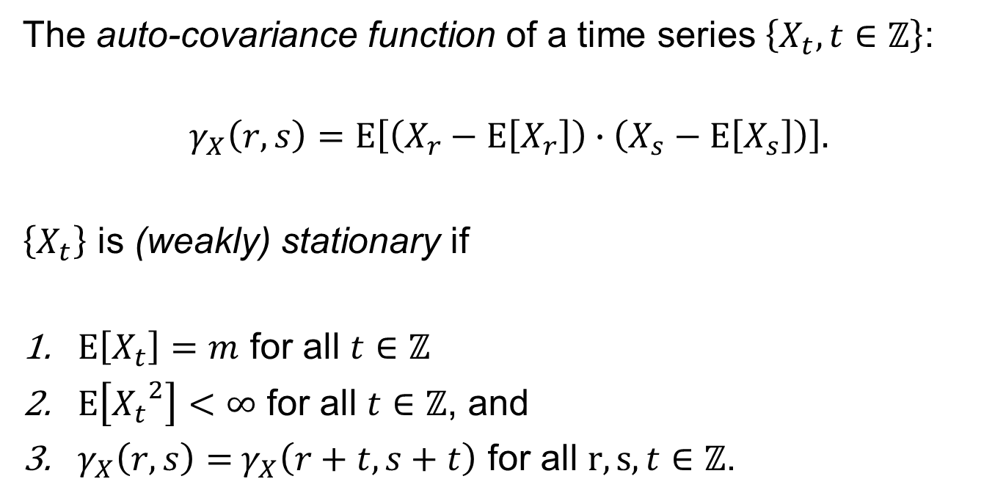
Time Series: Stationarity
The auto-covariance function of a time series $\left\{X_{t}, t∈ℤ\right\}$:
$$γ_{X}\left(r, s\right)=Ε\left[\left(X_{r}−Ε\left[X_{r}\right]\right)∙\left(X_{s}−Ε\left[X_{s}\right]\right)\right].$$
$\left\{X_{t}\right\}$ is (weakly) stationary if
$Ε\left[X_{t}\right]=m$ for all $t∈ℤ$
$Ε\left[{X_{t}}^{2}\right]<∞$ for all $t∈ℤ$, and
$γ_{X}\left(r, s\right)=$ $γ_{X}\left(r+t, s+t\right)$ for all $r, s, t∈ℤ$.

Slide 5
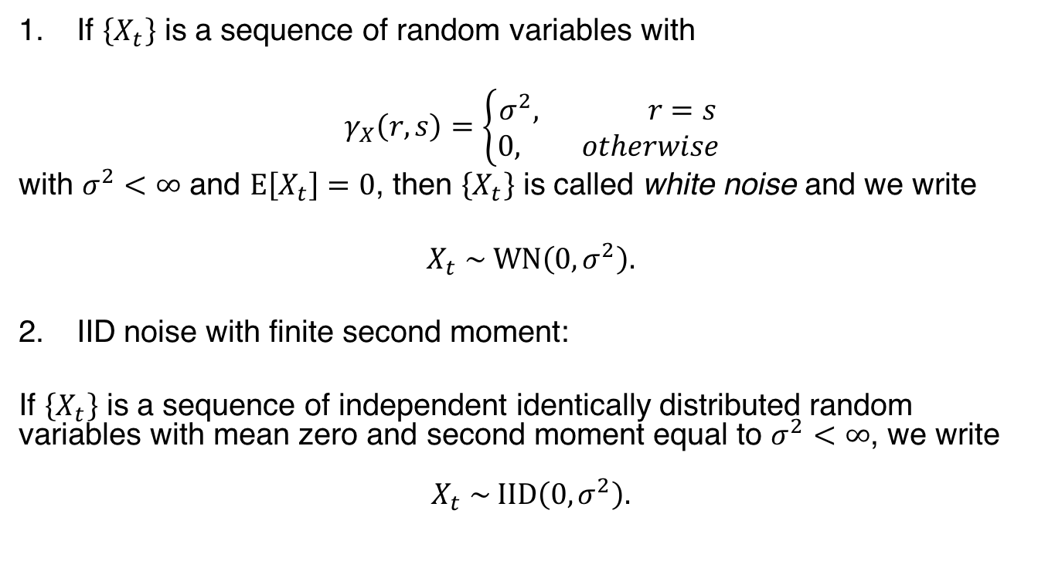
Examples of Stationary Time Series
If $\left\{X_{t}\right\}$ is a sequence of random variables with
$$γ_{X}\left(r, s\right)=\left\{\begin{aligned}σ^{2}, r=s \\ 0, otherwise\end{aligned}\right.$$
with $σ^{2}<∞$ and $Ε\left[X_{t}\right]=0$, then $\left\{X_{t}\right\}$ is called white noise and we write
$$X_{t} \sim \text{WN}\left(0, σ^{2}\right).$$
IID noise with finite second moment:
If $\left\{X_{t}\right\}$ is a sequence of independent identically distributed random variables with mean zero and second moment equal to $σ^{2}<∞$, we write
$$X_{t} \sim \text{IID}\left(0, σ^{2}\right).$$

Slide 6
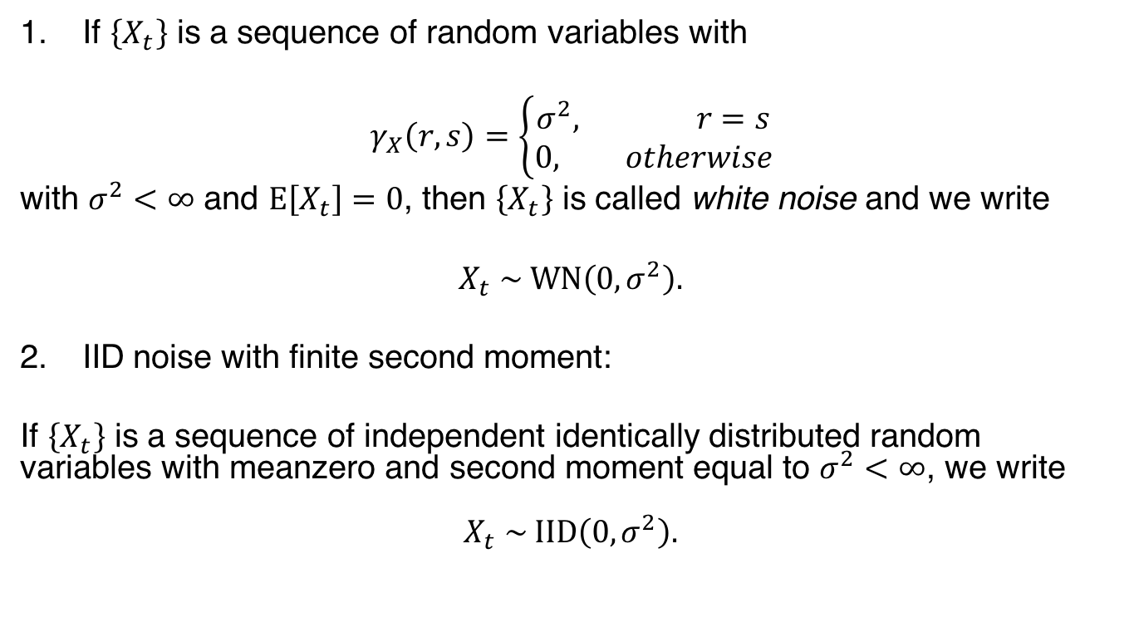

Examples of Stationary Time Series
If $\left\{X_{t}\right\}$ is a sequence of random variables with
$$γ_{X}\left(r, s\right)=\left\{\begin{aligned}σ^{2}, r=s \\ 0, otherwise\end{aligned}\right.$$
with $σ^{2}<∞$ and $Ε\left[X_{t}\right]=0$, then $\left\{X_{t}\right\}$ is called white noise and we write
$$X_{t} \sim \text{WN}\left(0, σ^{2}\right).$$
IID noise with finite second moment:
If $\left\{X_{t}\right\}$ is a sequence of independent identically distributed random variables with meanzero and second moment equal to $σ^{2}<∞$, we write
$$X_{t} \sim \text{IID}\left(0, σ^{2}\right).$$
What is the difference between $\text{WN}\left(0, σ^{2}\right)$ and $\text{IID}\left(0, σ^{2}\right)$?
Uncorrelated versus Independent
How to generate in the R statistical software?
Use rnorm, rpois, r…

Slide 7
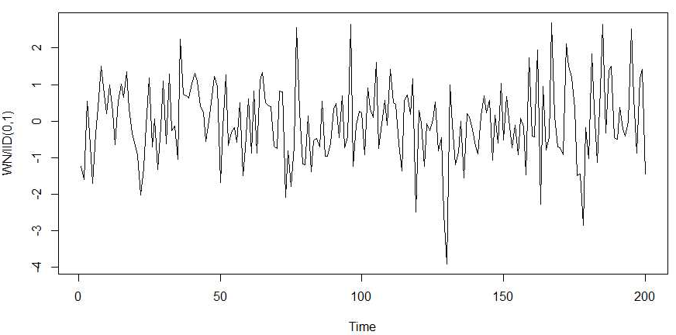

Examples of Stationary Time Series
What is the difference between $\text{WN}\left(0, σ^{2}\right)$ and $\text{IID}\left(0, σ^{2}\right)$?
Uncorrelated versus Independent
How to generate in the R statistical software?
Use rnorm, rpois, r…

Slide 8
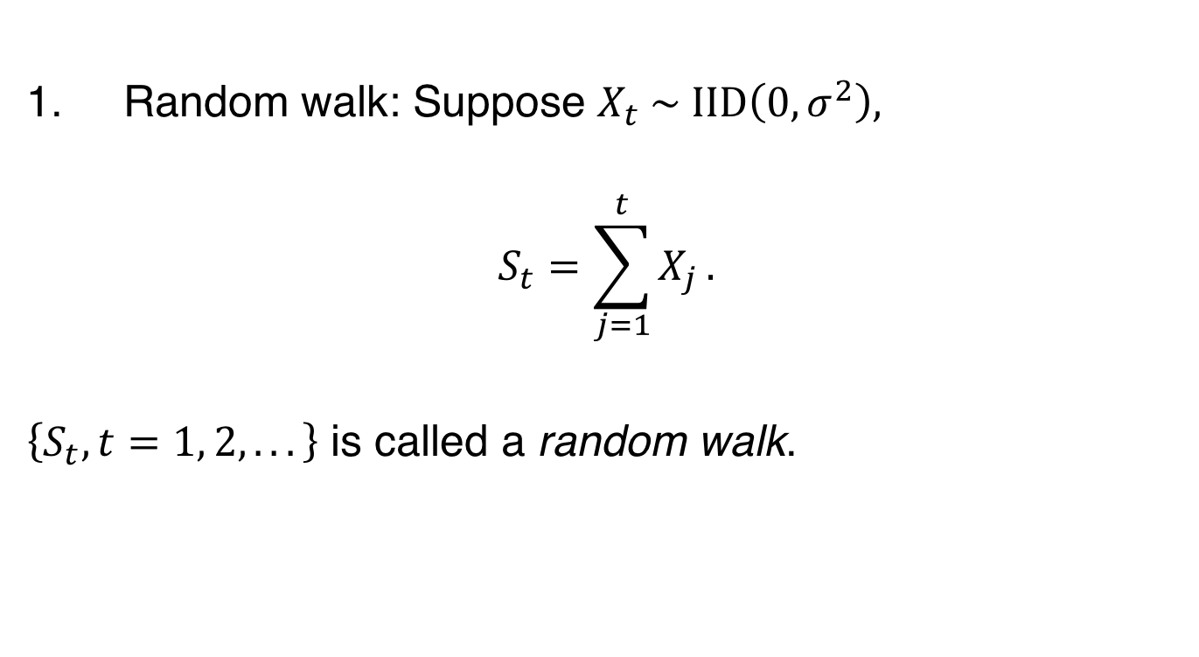
Examples of Non-Stationary Time Series
1. Random walk: Suppose $X_{t} \sim \text{IID}\left(0, σ^{2}\right),$
$$S_{t}=\sum_{j=1}^{t}{X_{j}}.$$
$\left\{S_{t}, t=1, 2, .. .\right\}$ is called a random walk.

Slide 9
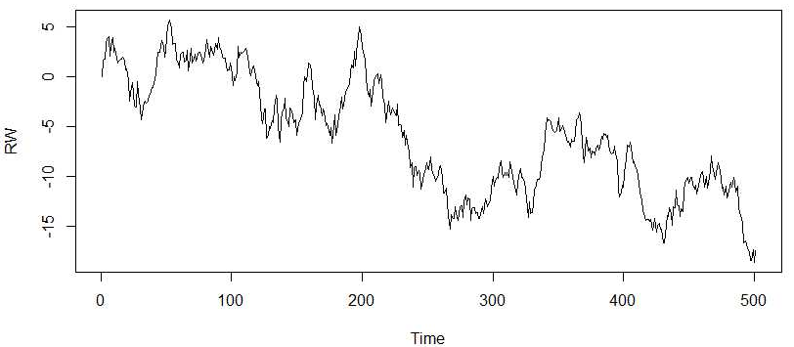

Examples of Non-Stationary Time Series
1. Random walk: Suppose $X_{t} \sim \text{IID}\left(0, σ^{2}\right),$
$$S_{t}=\sum_{j=1}^{t}{X_{j}}.$$
$\left\{S_{t}, t=1, 2, .. .\right\}$ is called a random walk.

Slide 10
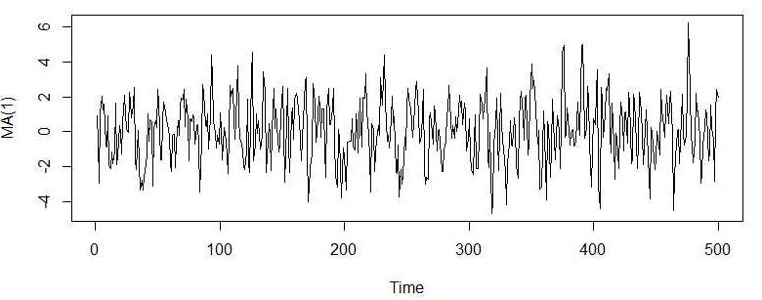

Examples of Non-Stationary Time Series
2. A Moving Average Process of Order 1 (MA(1)):
$$X_{t}=Z_{t}+θZ_{t+1}, t∈ℤ,$$
where $Z_{t} \sim \text{WN}\left(0, σ^{2}\right)$.

Slide 11
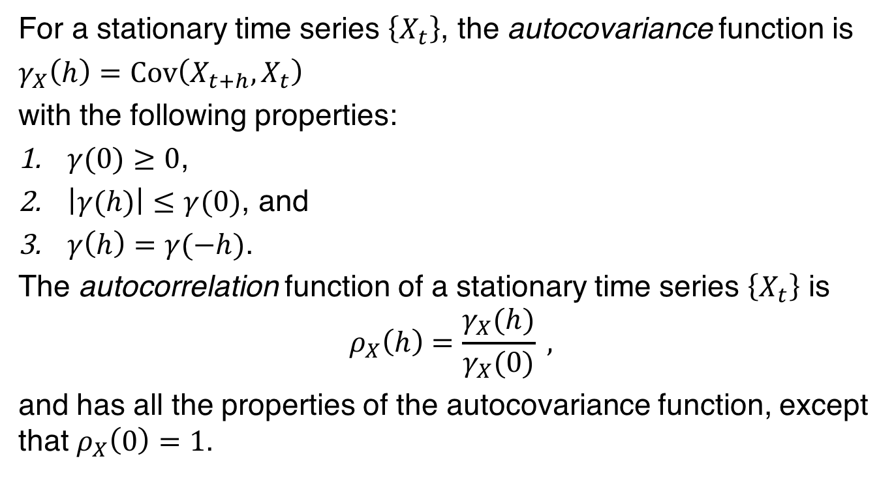
Autocovariance Function: Stationarity
For a stationary time series $\left\{X_{t}\right\}$, the autocovariance function is
$γ_{X}\left(h\right)=\text{Cov}\left(X_{t+h}, X_{t}\right)$
with the following properties:
$γ(0)≥0$,
$\left|γ(h)\right|≤γ(0)$, and
$γ\left(h\right)=γ(−h)$.
The autocorrelation function of a stationary time series $\left\{X_{t}\right\}$ is
$$ρ_{X}\left(h\right)=\frac{γ_{X}(h)}{γ_{X}(0)} ,$$
and has all the properties of the autocovariance function, except that $ρ_{X}\left(0\right)=1$.

Slide 12
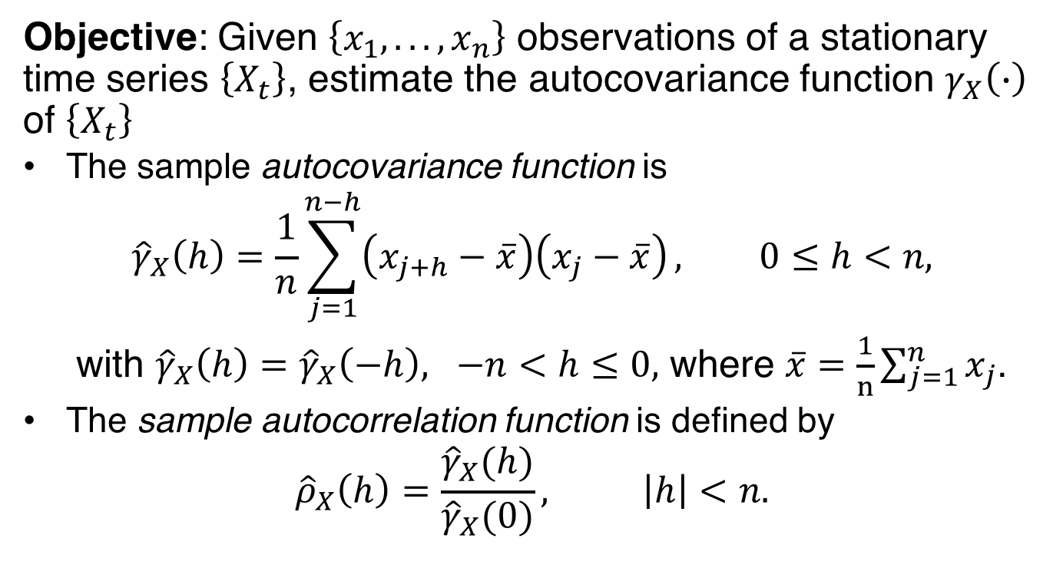
Autocovariance Function: Estimation
Objective: Given $\left\{x_{1}, .. ., x_{n}\right\}$ observations of a stationary time series $\left\{X_{t}\right\}$, estimate the autocovariance function $γ_{X}\left(∙\right)$ of $\left\{X_{t}\right\}$
The sample autocovariance function is
$${\hat{γ}}_{X}\left(h\right)=\frac{1}{n}\sum_{j=1}^{n−h}{\left(x_{j+h}−\overline{x}\right)\left(x_{j}−\overline{x}\right)}, 0≤h<n,$$
with ${\hat{γ}}_{X}\left(h\right)={\hat{γ}}_{X}\left(−h\right), −n<h≤0,$ where $\overline{x}=\frac{1}{n}\sum_{j=1}^{n}{x_{j}}$.
The sample autocorrelation function is defined by
$${\hat{ρ}}_{X}\left(h\right)=\frac{{\hat{γ}}_{X}(h)}{{\hat{γ}}_{X}(0)}, \left|h\right|<n.$$

Slide 13
Summary

